Slide 1

Bearcat Bites
Maria Smith
Ruksha Khadka
Avni Singh
Anishka Sutar
Rashmi Devkota
Winnie Duong

Slide 2
The Problem
The problems that have been highlighted mostly relate to the difficulties that students and faculty have when it comes to dining hall services.
Dining facilities frequently don't have sufficient information about diet-specific and healthy food options.
People are unaware of the current menu and nutritional facts and because of this, they struggle to find the appropriate dining choices for them.
Teachers and students who have busy schedules face challenges due to unpredictable traffic in the dining hall.
With limited information on maps such as Apple Maps or Google Maps, new students have difficulty locating dining halls.

Slide 3
The Solution – Dining Hall App
Weekly Menu Items
Current Traffic
Dining Hall Hours
Find offered menu items for each dining hall up to 7 days in advance
View live traffic of each dining hall and see popular crowd times based on time of day
Each dining hall has its weekly hours listed and shows changes for special holidays
Campus-Specific Directions
Dining Hall Events
Item Nutrition Info
Each food item's nutrition facts are listed
View a list of dining hall related events with times and locations
Navigation includes all possible pathways to find most efficient path

Slide 4
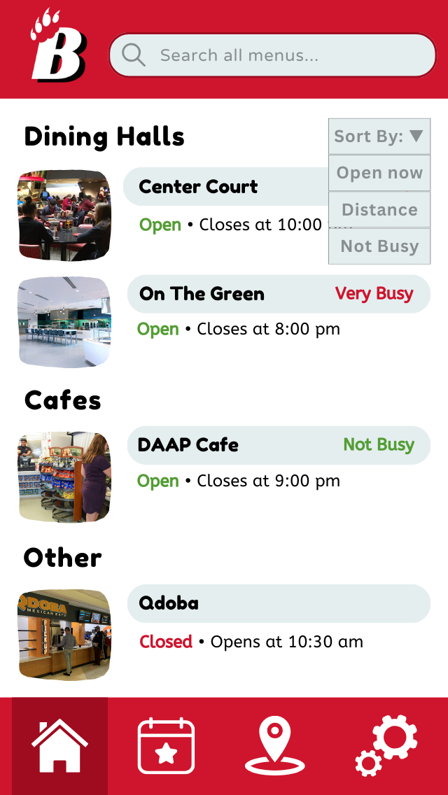
Home Page
Provides list of each dining hall
Can sort by:
Open/Closed
Distance (from user)
Current traffic
Search bar will search for items across all dining hall menus
Clicking on a dining hall will open a new page with more corresponding information →

Slide 5
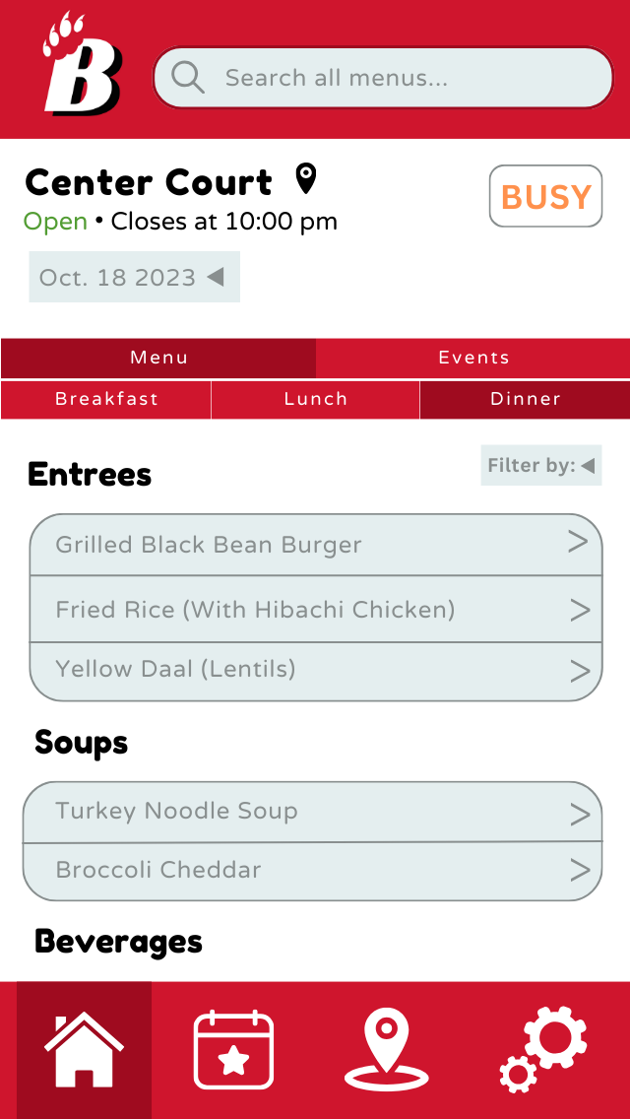
Dining Hall Page
Contains all necessary information pertaining to each dining hall

Slide 6
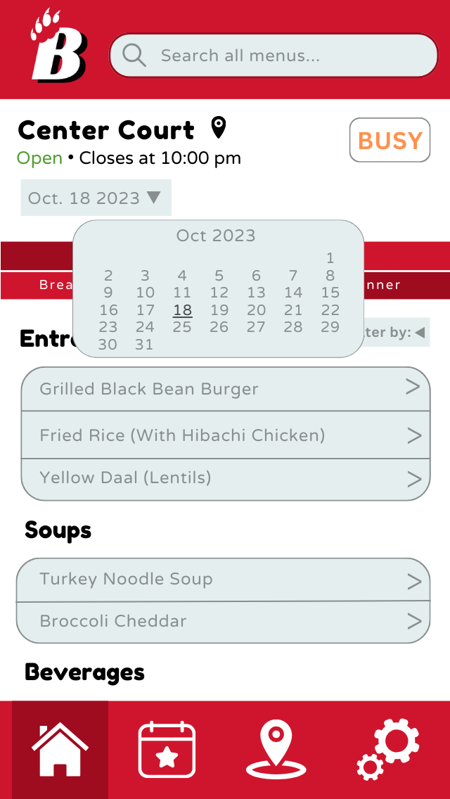
Daily Menu
Date feature
Allows user to choose to view current or future menu (up to 7 days)

Slide 7
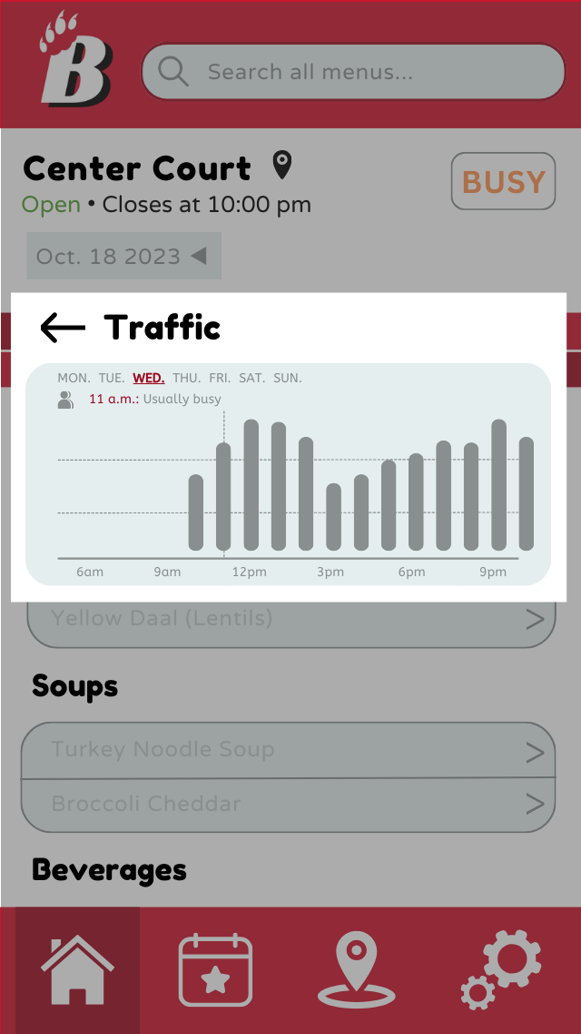
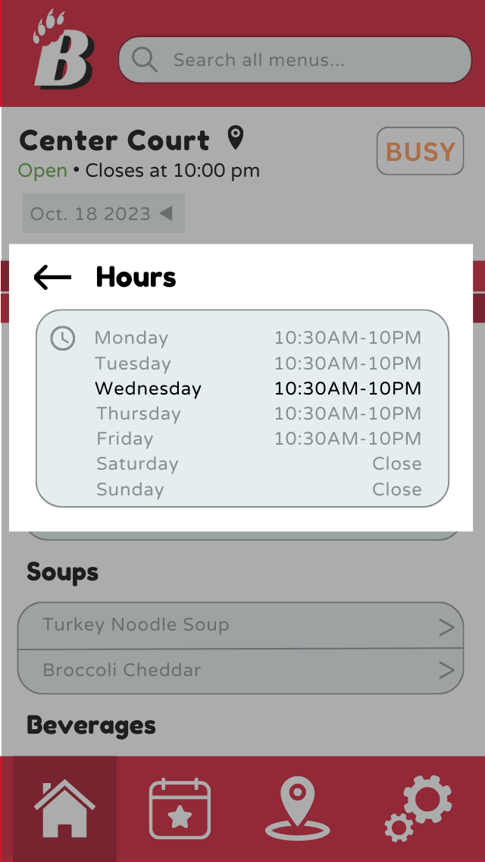
Traffic + Hours
User can view current traffic
Pop-up shows typical crowd rates
Measured by time of day
Can view dining hall hours
Will account for holiday hours when applicable

Slide 8
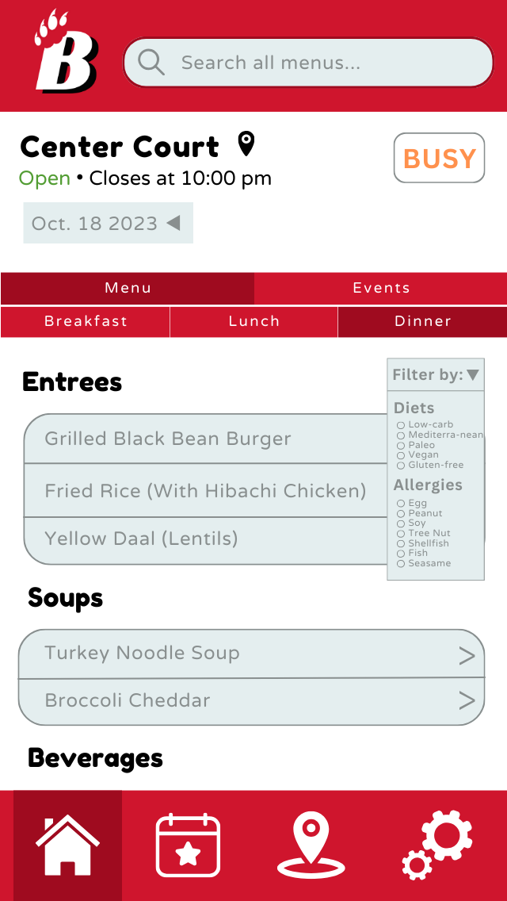
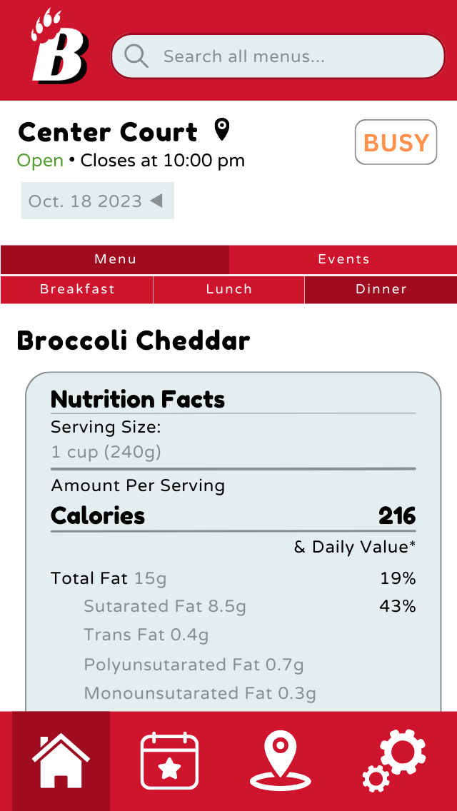
Nutrition
Menu accommodates for nutritional and dietary restrictions
Can filter by diet or allergens
Click on food item for nutritional information

Slide 9
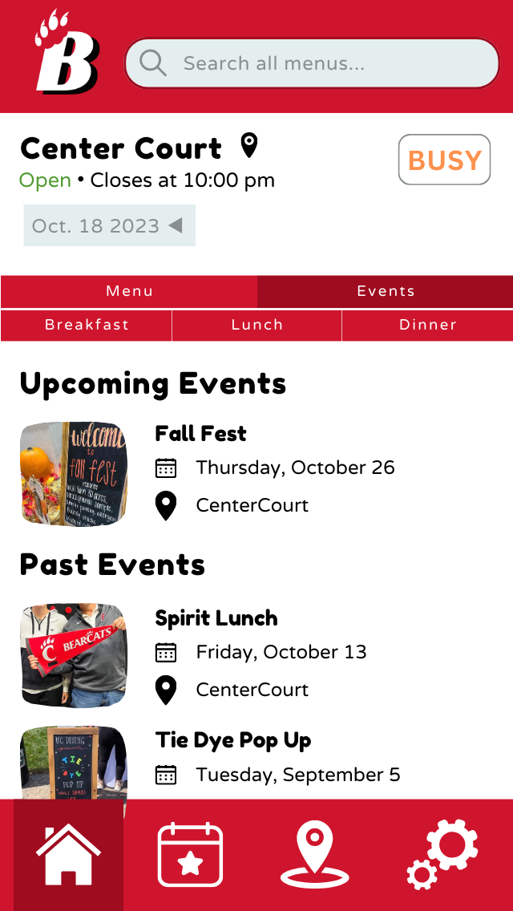
Dining Hall Events
View events specific to chosen dining hall
Description includes more info on event

Slide 10
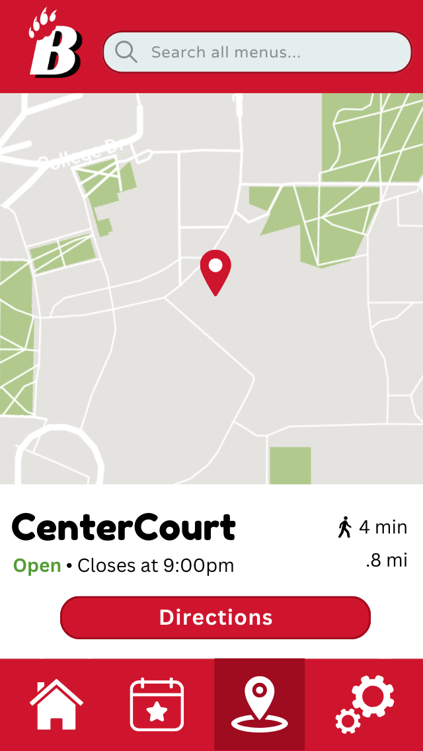
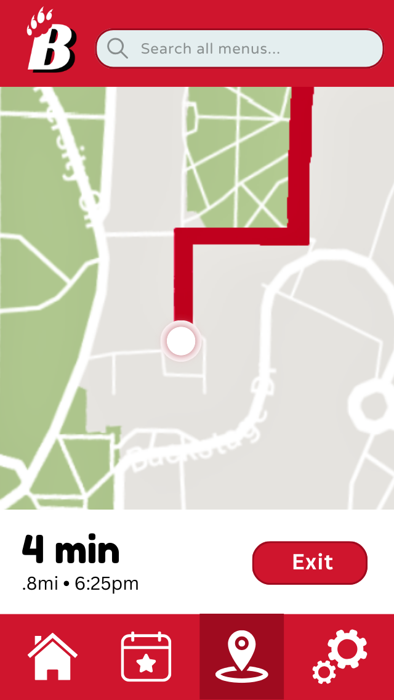
Navigation
Navigation icon on dining hall page leads to directions
Uses campus specific pathways to generate the most efficient way

Slide 11
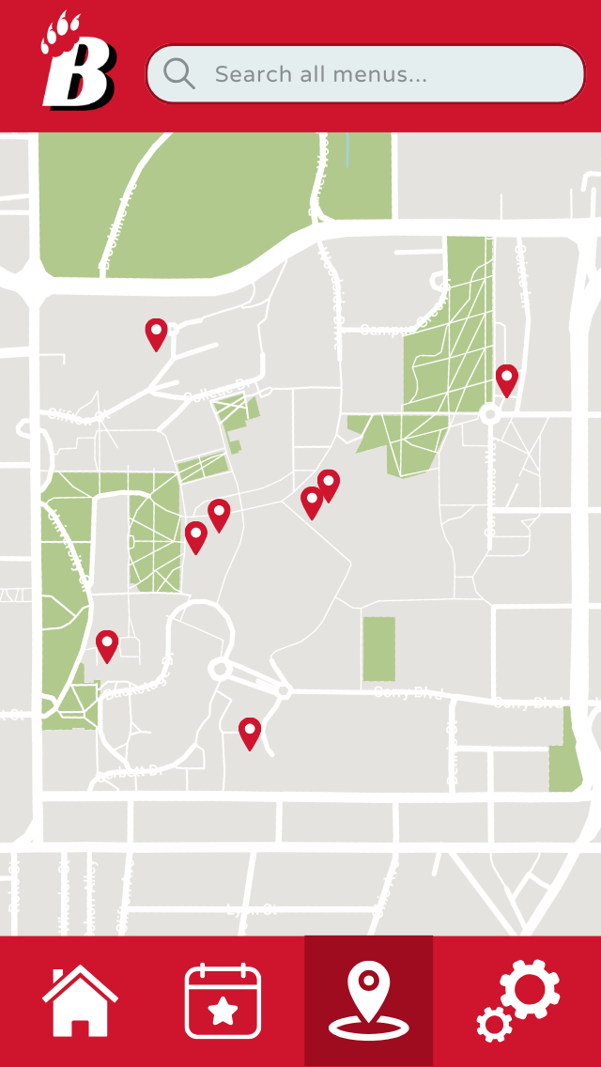
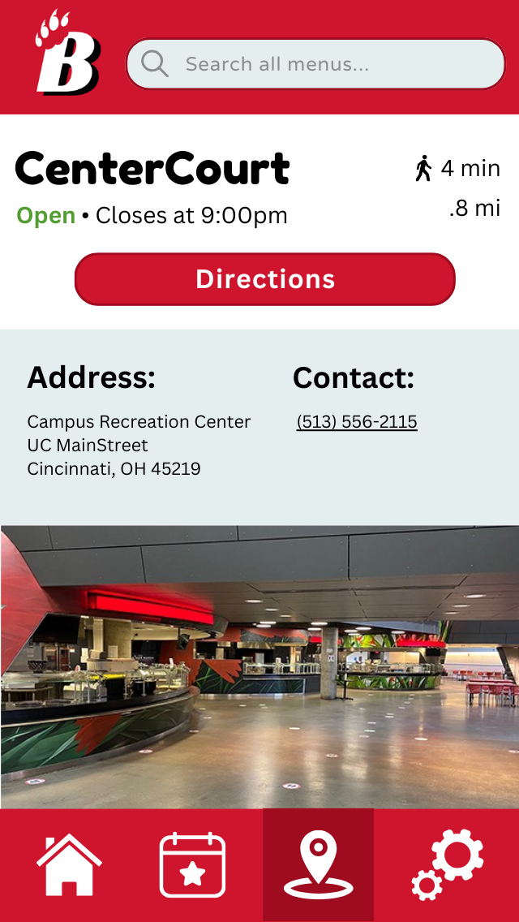
Navigation
Icon on bottom of screen also brings user to navigation map
Can interact with desired dining hall to get directions
Additional info is listed below

Slide 12
Testing and Next Steps
The interviewees provided overwhelmingly positive feedback. However, two consistent critiques we received were the lack of a food availability feature and insufficiently prominent features/buttons.
To address this feedback, we will be sure include the following in future versions of our app:
Outlines to the clickable features of our app
Make certain features more prominent (larger titles, etc.)
Availability markers for each food item

Slide 13
Reflection
What went well?
Is proposal a viable solution for the problem? Why or Why Not?
Effective group project planning strategies
Successfully designed, made, and tested very detailed prototypes of our proposal
Effectively planned appropriate group checkpoints to ensure timely and efficient completion of each assignment
We think our app is a viable solution because:
All dining hall information is now accessible from one location
Students/faculty can check multiple things on the app like times, menus, wait times, etc.
Users can figure out the quickest route to dining halls using the app's unique navigation system

Slide 14
Reflection
What didn't go so well?
What would you do differently next time?
Difficulty with the use case section
Communication
Shortcomings in the layout of the prototype
Proactive approach to improve group dynamics
Emphasize the importance of detailing and double-check each aspect of the project

Slide 15
Reflection: What We Learned
Anishka: what the process for proposing and developing an app/solution looks like.
Maria: effectively plan, divide, and distribute work for a group project to ensure timely and efficient completion.
Ruksha: the detailed process of developing an app from proposal to user testing, the importance of communication, cooperation, and mutual understanding in group work.
Rashmi: How to effectively summarize completed work and project milestones.
Winnie: the importance of effective communication, understanding how to convey thoughts, share responsibilities and address challenges within a team.
Avni: what all goes into the development and creation of an app and how it can be much harder than it looks.

Slide 16
Thank you for watching!

